Slide 1
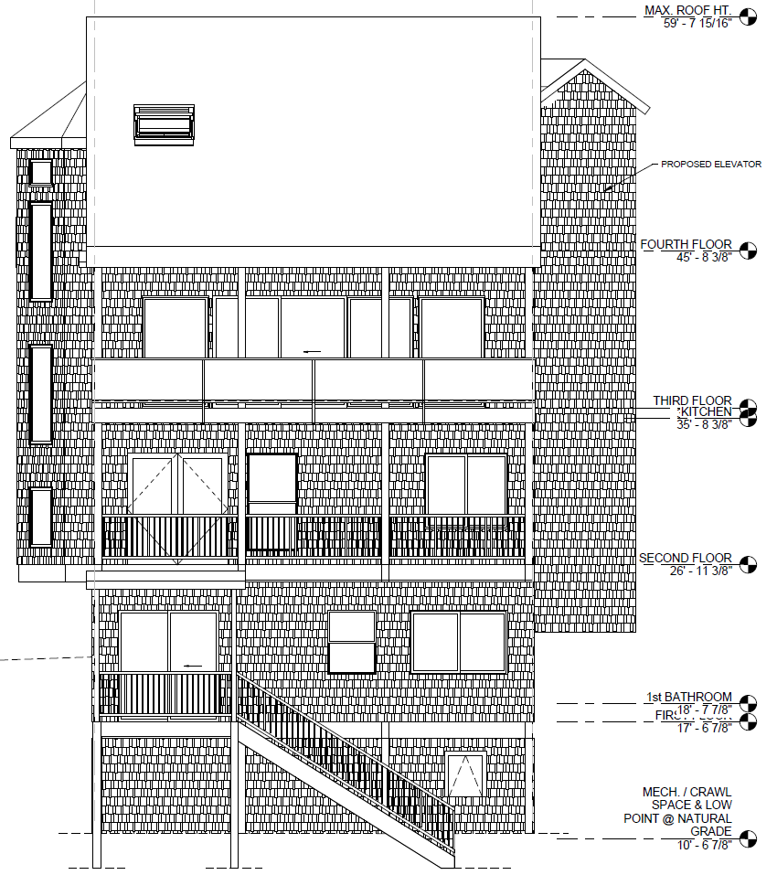
WPVAR18-0007 Yount Elevator
Washoe County
Board of Adjustment
October 4, 2018

Slide 2
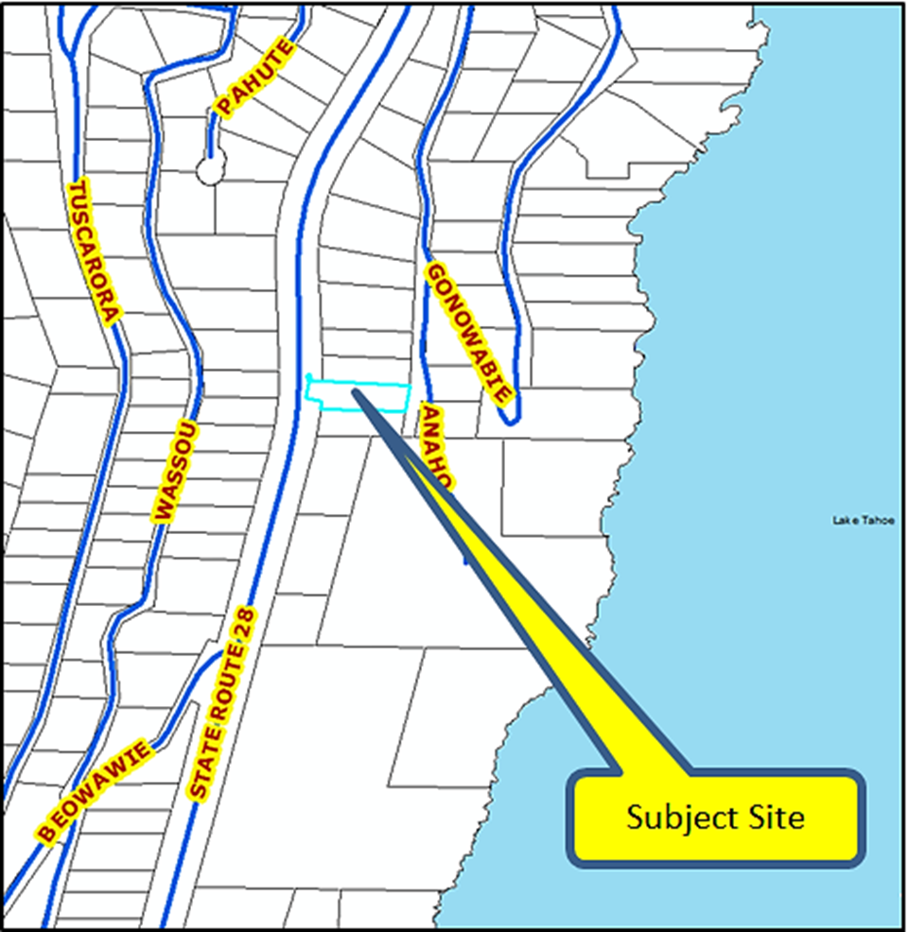
Location
400 State Route 28, Crystal Bay

Slide 3
Overview
To reduce the side yard setback from 5 feet to ±2 inches to allow for the construction of an elevator within a residence along the north side property line.

Slide 4
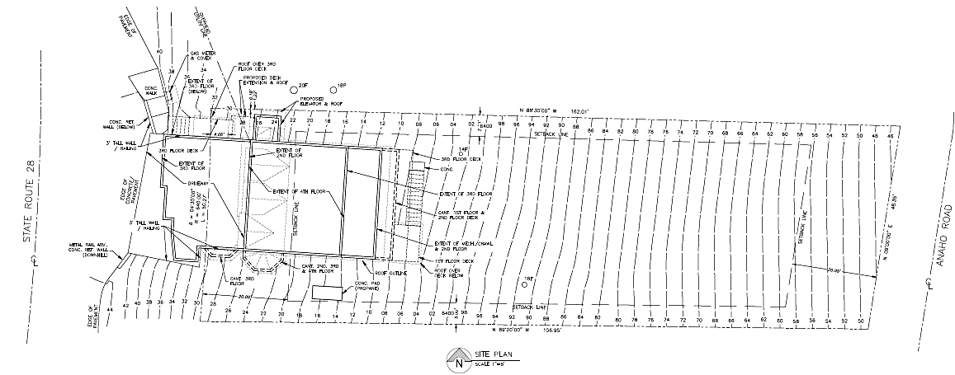
Site Plan

Slide 5
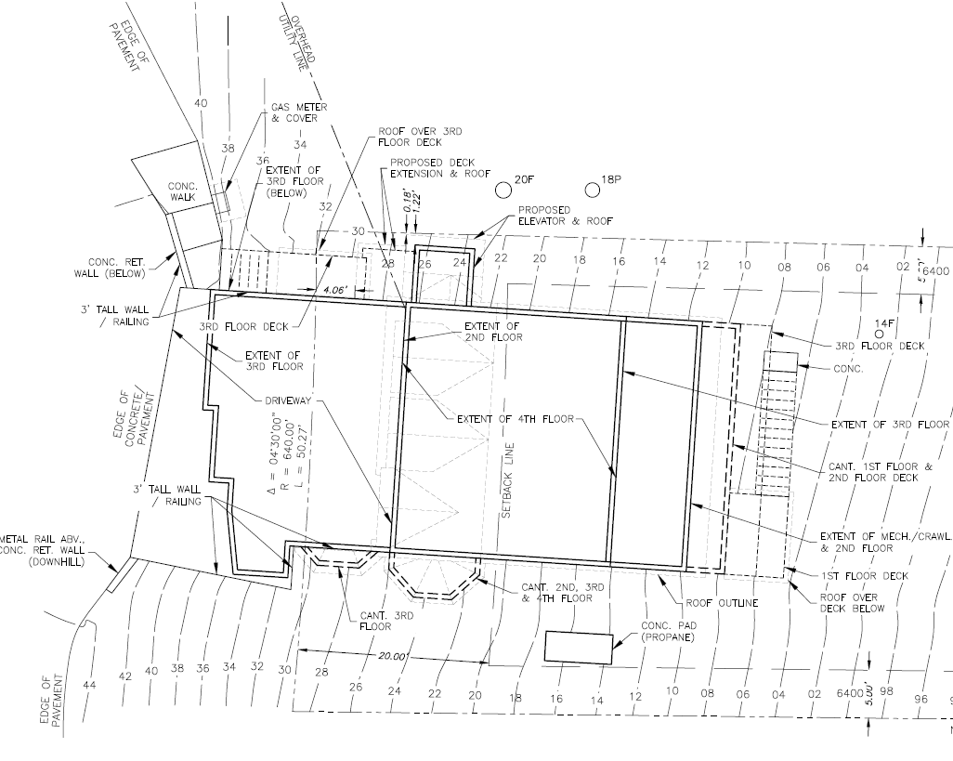
Detail Site Plan

Slide 6
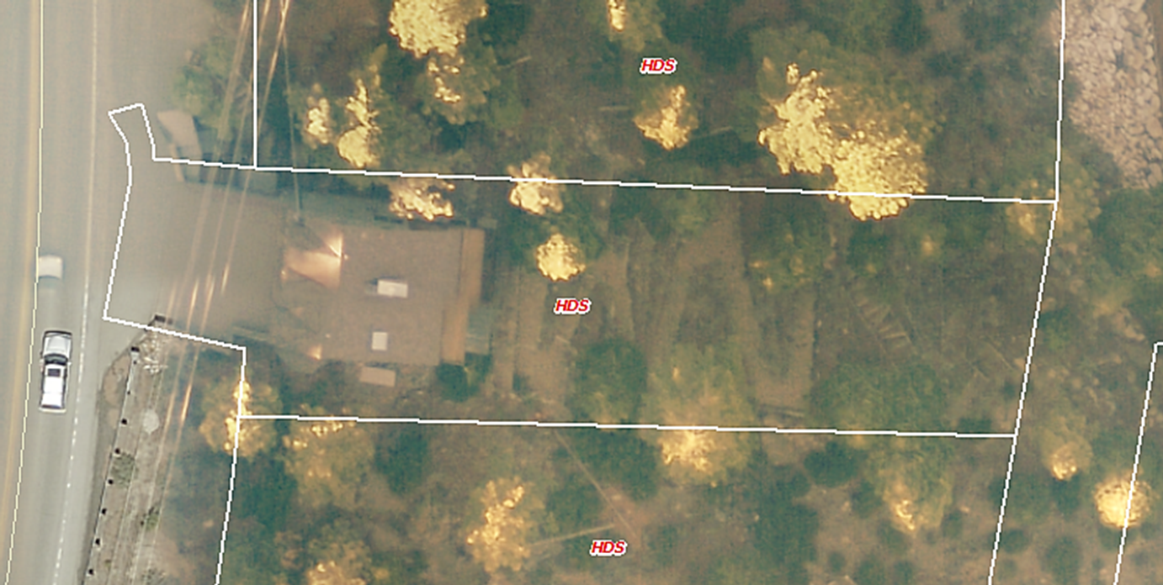
Overhead Photo

Slide 7
Variance Purpose
The purpose of a Variance is to provide a means of altering the requirements in specific instances where the strict application of those requirements would deprive a property of privileges enjoyed by other properties with the identical regulatory zone because of special features or constraints unique to the property involved.

Slide 8
Variance Evaluation
Nevada Revised Statues (NRS) limits the power of the Board of Adjustment to grant variances only under particular circumstances. The applicant has the responsibility to demonstrate that the subject property exhibits one or more of the following characteristics to demonstrate a hardship: 1) exceptional narrowness, shallowness, or shape of a specific piece of property; or 2) by reason of exceptional topographic conditions; or 3) other extraordinary and exceptional situation or condition of the piece of property.

Slide 9
Variance Evaluation
The regulatory zone of the subject parcel of land is High Density Suburban (HDS). The minimum lot width for that zone is 60 feet. The subject parcel is approximately 48 feet in width. While the parcel is narrower than would be allowed if it were a newly created parcel, there remains approximately 16 feet between the foundation of the dwelling and the southern property line.
The narrowness is not “exceptional.”

Slide 10
Variance Evaluation
The subject parcel is approximately 157 feet in depth.
The subject parcel is not exceptionally shallow.

Slide 11
Variance Evaluation
The subject parcel is essentially rectangular.
The parcel is not exceptionally shaped.

Slide 12
Variance Evaluation
The subject parcel contains a significant down-slope from State Route 28 to Anaho Road. Similar slopes are common in the Tahoe Area and in Crystal Bay area in particular. The slope does not inhibit the construction of an elevator adjacent to the south side or east end of the existing dwelling.

Slide 13
Fair Housing Act and Americans with Disabilities Act.
Evaluation on pages 8 and 9 of the Staff Report
Fair Housing Act: May apply if other reasonable options are not available.
The addition may be reasonably located to the south or east sides of the existing structure without encroaching upon the required building setbacks.
Americans with Disabilities Act: Probably does not apply in this case.

Slide 14
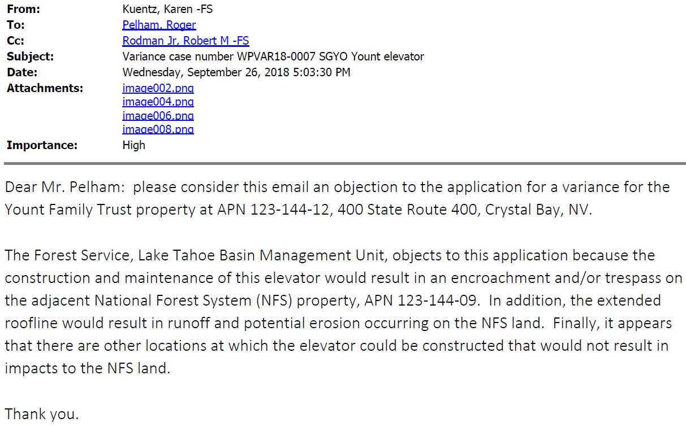
Variance Evaluation
Roof eaves proposed within 2 inches of the north property line.

Slide 15
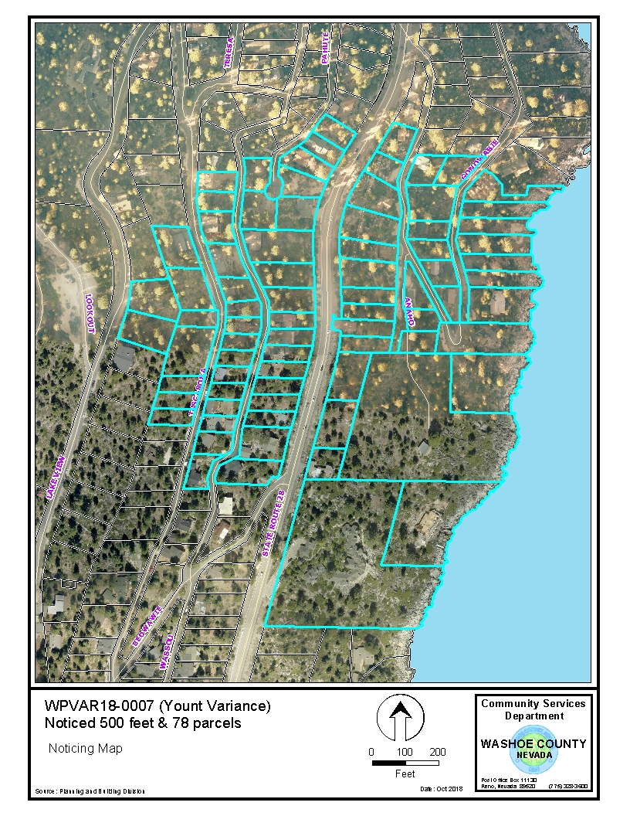
Public Notice and CAB
78 Parcels noticed at 500 foot radius
IV / CB CAB on September 4, 2018 recommended approval

Slide 16
Commenting Agencies
Incline Village General Improvement District:
No Impact
Washoe County Planning
No Hardship, therefore recommends denial
US Forest Service
Impact upon Forest Service Land is anticipated, therefore recommends denial

Slide 17
Variance Findings
Findings and evaluation can be found on pages 10 and 11 of the staff report.
Staff believes that findings requiring “Special Circumstances” and “No Detriment” cannot be made, as noted earlier.
Also, the finding requiring “No Special Privileges” cannot be made as there are no “Special Circumstances.”

Slide 18
Possible Motion
I move that, after giving reasoned consideration to the information contained in the staff report and information received during the public hearing, the Washoe County Board of Adjustment deny Variance Case Number WPVAR18-0006 for G. Stuart and Geraldine M. Yount Family Trust, being unable to make all required findings in accordance with Washoe County Development Code Section 110.804.25, particularly “Special Circumstances,” “No Detriment” and “No Special Privileges”.

